Slide 1

CENG113M – Lab 5
Sequences: Strings and Lists

Slide 2

Goal & Focus
Goal
Using strings and lists to solve data analysis, cryptography, and logic problems.
Today’s focus
•
String methods
•
List methods (All 11 built-in methods!)
•
String immutability
•
Indexing and negative indexing
•
+, in, * operators
•
Traversing a list with

Slide 3
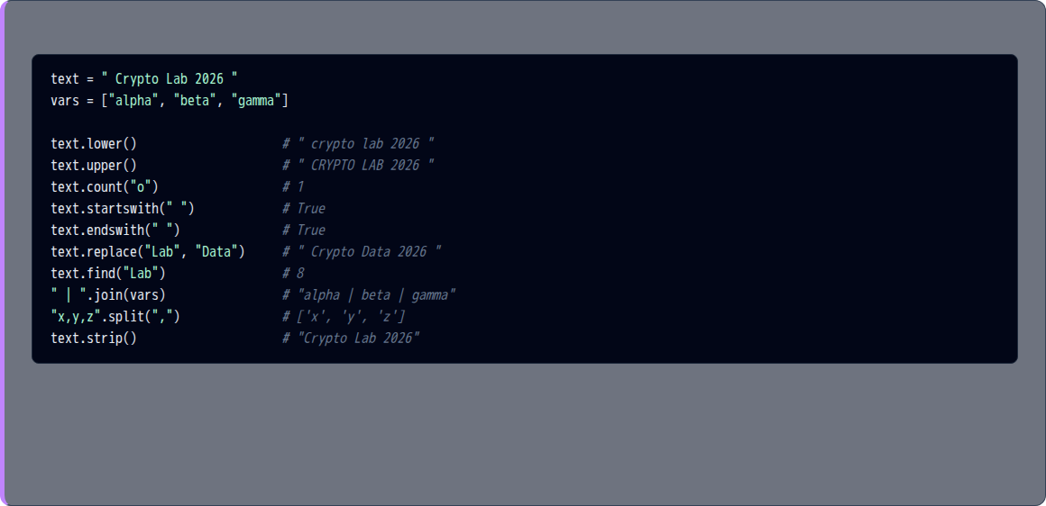
String Methods Summary
Python
Important: Strings are immutable. Methods like upper() or replace() return a new string.

Slide 4
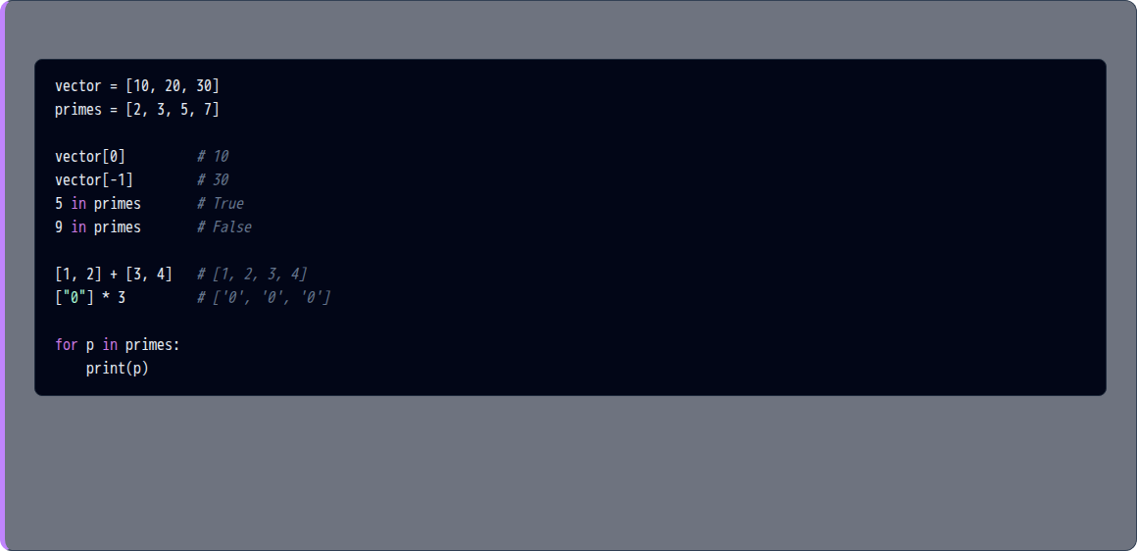
List Tools Summary
Python

Slide 5
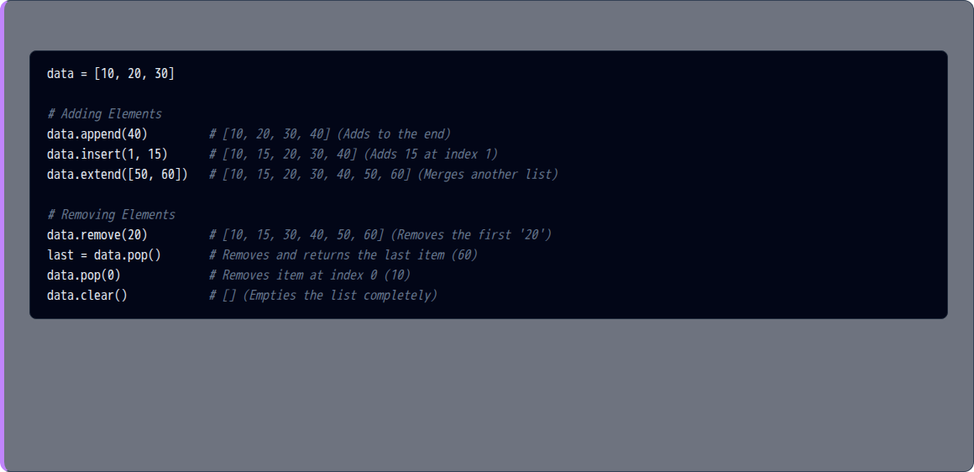
List Methods I: Adding & Removing
Python

Slide 6
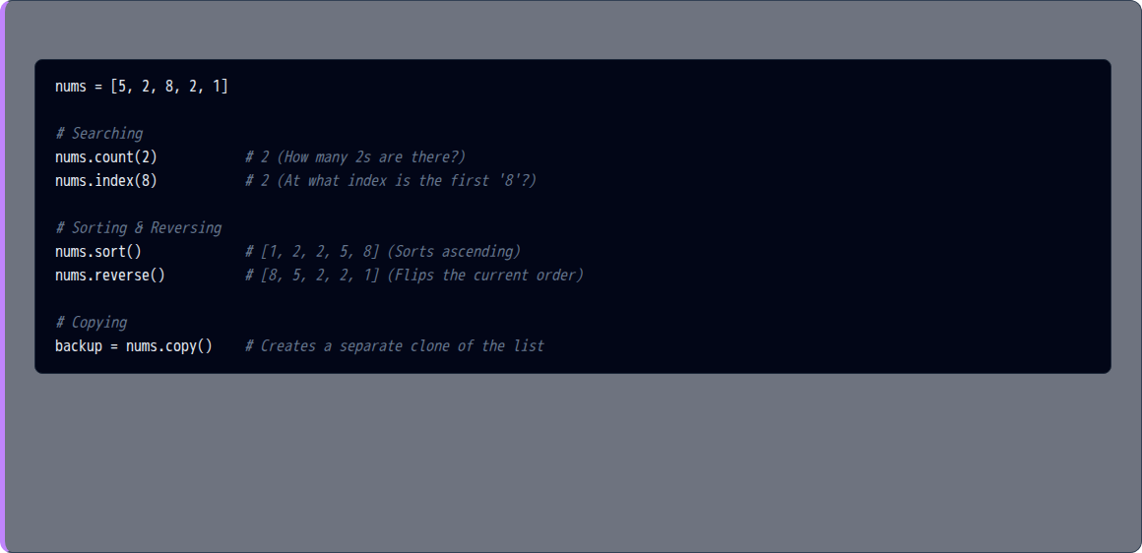
List Methods II: Searching, Sorting & Copying
Python

Slide 7




Exercise 1: Protocol Decryption
The Scenario
In secure communications, messages have a specific prefix. We need to verify the prefix, strip the noise, and normalize the text.
The Mission
Retrieve a message from the user. Secure messages always start with the "ENC-" prefix, but they might have accidental spaces at the beginning or end. Verify if the message is authentic. If it is, extract the hidden secret by removing the prefix and converting the remaining text to lowercase. Otherwise, warn the user about the invalid protocol.
(Hint: .strip(), .startswith(), .replace(), .lower())
Expected Output

Slide 8

Exercise 2: Dataset File Formatter
The Scenario
A data analysis tool only accepts .csv files and cannot process filenames with spaces. We need to clean the user's file input.
The Mission
Get a filename from the user. Server systems crash if filenames contain spaces, so safely replace any spaces with underscores. Locate the exact position of the file extension dot to see where the name ends. Finally, ensure the file is in CSV format; if it's missing the ".csv" extension, automatically append it to the filename.
(Hint: .replace(), .find(), .endswith(), +)
Expected Output

Slide 9

Exercise 3: Equation Parser
The Scenario
A Computer Algebra System needs to break down a user's equation string to separate the Left-Hand Side (LHS) and Right-Hand Side (RHS), and count the variables.
The Mission
Ask the user for an algebraic equation. Standardize the input by removing all spaces and converting it to uppercase. Count how many times the variable "X" is used. Then, mathematically separate the Left-Hand Side (LHS) from the Right-Hand Side (RHS) of the equation and display them individually.
(Hint: .replace(), .upper(), .count(), .split("="))
Expected Output

Slide 10



Exercise 4: Cryptographic Key Generator
The Scenario
In cryptography, a short base key is often repeated to match the length of a message, and then combined into a single string.
(Given: )
The Mission
Ask the user for a multiplier N. Expand the given base_key sequence by repeating it N times to create a much longer array. Once you have the full array, fuse it into a single readable text string where each character is separated by a hyphen ("-").
(Hint: *, .join())
Expected Output

Slide 11


Exercise 5: Statistical Mean
The Scenario
A statistician needs to collect exactly 5 experimental data points from the user and calculate the arithmetic Mean.
The Mission
Collect exactly 5 experimental numerical samples from the user. Store all these points in a dataset sequence. Calculate the arithmetic mean of these collected samples and print both the full dataset and the calculated mean.
(Hint: for loop, .append(), / 5)
Expected Output

Slide 12



Exercise 6: Binary Dominance
The Scenario
A digital signal is processed as a list of bits. We need to determine if the signal is biased towards High (1) or Low (0).
(Given: )
The Mission
Analyze the given binary signal. Determine the frequency of High (1) and Low (0) states. Conclude and print whether the signal is "High dominant", "Low dominant", or "Balanced" based on which state appears more often.
(Hint: List .count(), if / elif / else)
Expected Output

Slide 13

Exercise 7: Scalar Multiplication
The Scenario
In linear algebra, multiplying a vector by a scalar means multiplying every element by that number.
(Given: )
The Mission
Ask the user for a scalar multiplier k. Apply scalar multiplication to the given vector, meaning every individual component of the vector must be multiplied by k. Generate and print the resulting scaled vector.
(Hint: for x in vector:, .append())
Expected Output

Slide 14



Exercise 8: The Telemetry Queue
The Scenario
A sensor sends an array of telemetry data. The very last element is always a status code (1=Active, 0=Offline). Also, the sensor sometimes outputs -999.0 when it glitches.
(Given: )
The Mission
The telemetry data contains a status flag at the very end and a known glitch value (-999.0) somewhere inside. Separate the status flag from the rest of the data. Then, locate the exact position of the glitch, log its index, and permanently remove the glitch from the dataset.
(Hint: .pop(), .index(), .remove())
Expected Output

Slide 15

Exercise 9: Sorting the Leaderboard
The Scenario
A math competition has ended. The organizers want to see the scores ordered from Highest to Lowest to easily pick the top performers.
(Given: )
The Mission
Reorganize the unsorted competition scores so that they are ordered strictly from highest to lowest. Display the finalized standings and officially announce the Champion (the highest score).
(Hint: .sort(), .reverse(), indexing [0])
Expected Output

Slide 16

Exercise 10: Matrix Homogeneous Coordinates
The Scenario
In computer graphics and geometry, to translate a 2D vector, we often extend it with new data and add a 1.0 at the very beginning (Homogeneous coordinates).
(Given: and )
The Mission
Transform the 2D vector by expanding it with the additional dimensions provided in the second list. Furthermore, complete the homogeneous coordinate transformation by injecting the value 1.0 at the absolute beginning of the final vector.
(Hint: .extend(), .insert())
Expected Output

Slide 17



Exercise 11: Set Theory & Memory Wipe
The Scenario
In Set Theory, a set cannot have duplicates. We will manually build a unique list of coordinates, back it up to memory, and then wipe the original list for system security.
The Mission
Collect 4 coordinate names from the user, ensuring strictly that no duplicates are allowed into your collection (emulating mathematical sets). Once the unique set is built, create a secure backup in memory, and then completely wipe the original set to prevent data leaks. Display both the backup and the wiped original.
(Hint: if item not in..., .append(), .copy(), .clear())
Expected Output

